Slide 1
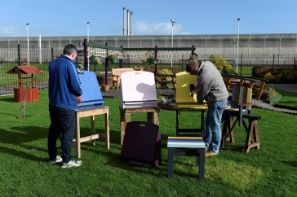
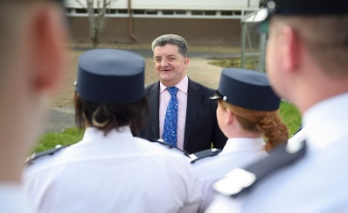
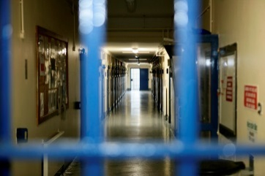
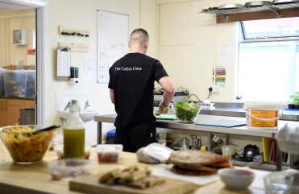
Prisons 2020
Driving continuous improvement in the Prison Service
Response document
Making the community safer by supporting people to change

Slide 3
Prisons 2020 – response document
Thank you for responding to Prisons 2020 – a discussion document. This is your opportunity to give your views on how we can all continue to improve our prisons to ensure we play our part in building a safe community in Northern Ireland.
This consultation will last until 29 September 2017 and there are three ways to give your views:
For staff and people in custody - take part in one of the focus groups in your establishment. Ask for details.
Email us at prisons.2020@justice-ni.x.gsi.gov.uk
Complete this document and return to the email address above or to:
Prisons 2020, Room 310, Dundonald House, Belfast BT4 3SS
If you have any queries please do not hesitate to contact us.

Slide 4
Role of the Prison Service
Please refer to Page 9 of discussion document)
Q1 Do you believe NIPS has appropriately summarised its role and defined its key strategic priorities. If you have answered “no” please outline your views in relation to the changes you would wish to suggest.
Your response
9

Slide 5
Our People
Our People - Questions | Your views - please refer to page 10 of the discussion document
Q2. What do you believe our organisational values should be?
Q3. How can we better work in partnership with our staff and trade union partners?
Q4. How can we improve communication with our staff and those who work with them in the prison environment?
Q5. How can we best capture and share examples of good practice across NIPS and in doing so celebrate success?

Slide 6
Our People (continued)
Our People - Questions | Your views - please refer to page 10 of the discussion document
Q6. How can we deliver better work-life balance for staff, and support their health and well-being?
Q7. How can we develop our leadership capability and in particular support first line managers?
Q8. What measures could we take to support staff health and well-being.
Q9. In recognition of the diversity of those in our care would it be helpful to have bespoke staff training for specific prisoner groups? If so, what training would be helpful?

Slide 7
Our Services
Our Services - Questions | Your views - please refer to pages 11-12 of the discussion document
Q10 How well do you think the Prison Service performs in prioritising resettlement and rehabilitation?
Q11 What could the Prison Service to differently to better support people’s transition from custody back into the community?
Q12 Are there models of good practice that the Prison Service could adopt to improve its approach to resettlement and rehabilitation?
Q13 What outcomes can the voluntary and community sector provide to assist with people’s resettlement and rehabilitation?

Slide 8
Our Infrastructure
Our Infrastructure - Questions | Your views - please refer to pages 13-14 of the discussion document
Q14. Do you think NIPS could make better use of the facilities/accommodation available to us, if so how?
Q15. Do you think there are other ways NIPS could achieve our infrastructure objectives? If so please outline your proposals.
Q16. How do you believe NIPS could better use technology to develop a whole prison approach, improve family connections and prepare individuals for release?

Slide 9
Our Partnerships
Our Partnerships - Questions | Your views - please refer to page 15 of the discussion document
Q17. How do you think NIPS could make better use of our partnerships?
Q18. How could NIPS improve communication with our partners?
Q19. How do you think NIPS could make better links with the community?

Slide 10
Additional comments
Please use this page for any further responses to the discussion document.

Slide 11
Your details
Name (optional):
Organisation:
Position:
Address:
Tel:
Email:
Thank you for responding to Prisons 2020: A discussion document.
All personal details will be held in strictest confidence and will not be shared with any third party or made public without your prior consent.
If you have any questions about the discussion document, please contact us at prisons.2020@justice-ni.x.gsi.gov.uk

